Slide 1
Health care data confidentiality

Slide 2
Abstract
This research focuses on fortifying healthcare data security through the integration of advanced data masking and encryption techniques. The proposed solution involves implementing data masking to obfuscate sensitive identifiers and medical details within the healthcare database, ensuring that only authorized personnel have access to the original patient information. Simultaneously, encryption techniques are applied to protect data both in transit and at rest, employing strong cryptographic algorithms to secure patient records during transmission and storage.

Slide 3
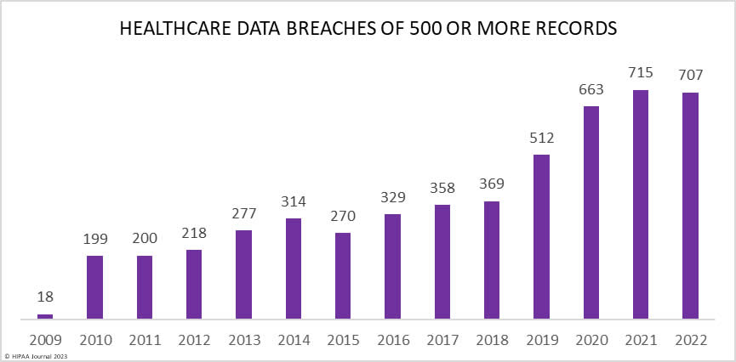
Problem statement
In the healthcare industry, maintaining the confidentiality of patient data is of utmost importance. The challenge is to ensure that sensitive healthcare data is securely protected both in production systems and non-production environments where data is used for testing and development.

Slide 4
Broad overview of solution
DATA MASKING:
Data masking is an essential aspect of data engineering, and it falls under the broader umbrella of data security and privacy within the context of data engineering practices.
Data masking is a specific technique used within the lifecycle of data engineering to address privacy and security concerns.

Slide 5
Data is cateogorized into two types in the context of data masking: Masked data and Unmasked data.
Masked data:
Masked data in data masking involves applying techniques to alter or hide specific elements within the dataset to protect sensitive information.
Unmasked data:
Unmasked data in data masking refers to the original, unaltered form of sensitive information that exists in the production environment.

Slide 6


Slide 7
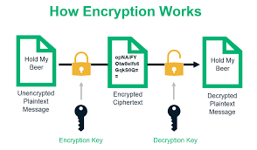
ENCRYPTION:
Encryption is a process of converting readable data, known as plaintext, into an unreadable format, known as ciphertext, using an algorithm and an encryption key.
Encryption is a critical component of cybersecurity, playing a fundamental role in protecting sensitive data and ensuring the confidentiality and integrity of information.

Slide 8
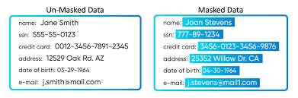
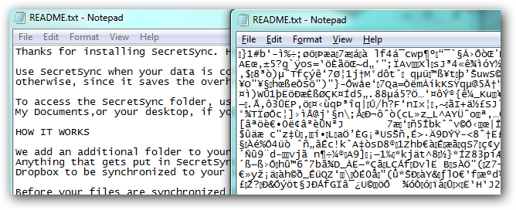
} data masking
} encryption

Slide 9

Protecting Patient Records in Production Systems:
Implementing strong encryption for patient records in the production database. This ensures that the sensitive information remains encrypted and unreadable without the appropriate decryption keys.
Secure Data Transmission in Healthcare Networks:
Utilize encryption protocols for secure data transmission. Encrypt patient data during its journey across healthcare networks to ensure that it remains confidential.

Slide 10
Safeguarding Patient Privacy in Research and Development:
Apply data masking techniques to create de-identified datasets for research and development. Masking techniques replace or anonymize sensitive patient information while maintaining the realism of the data. Encryption should also be employed to secure these datasets during storage and transmission.
Employee Access to Patient Information:
Utilize encryption to restrict access to authorized personnel with appropriate credentials. Implement data masking for non-production copies et realistic data.

Slide 11


pseudo code for rsa algorithm to implement encryption:

Slide 12

Pseudo code for data masking implementation

Slide 13
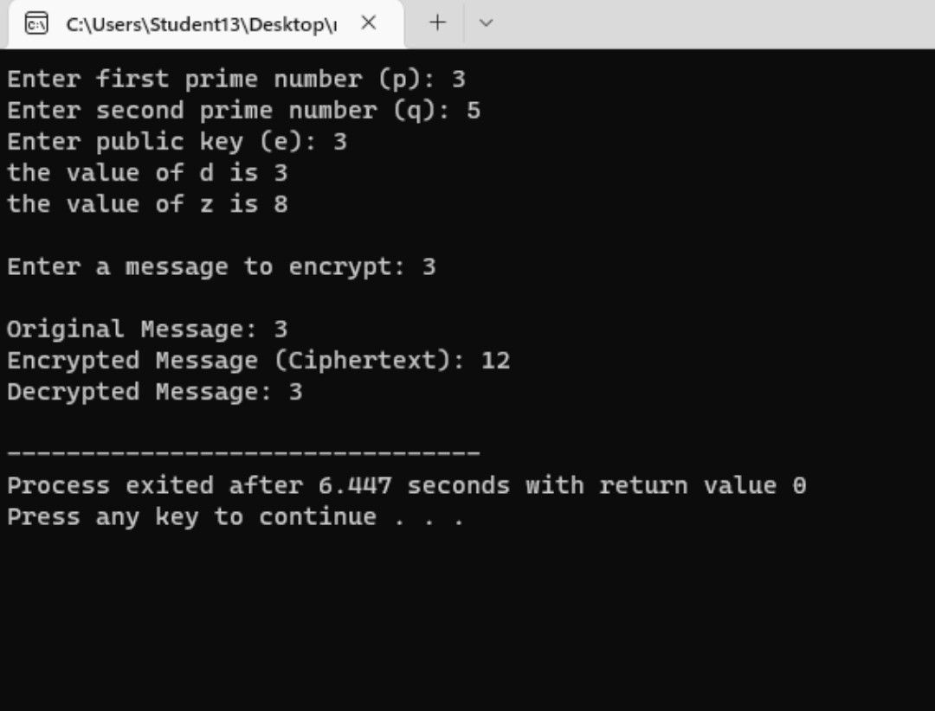
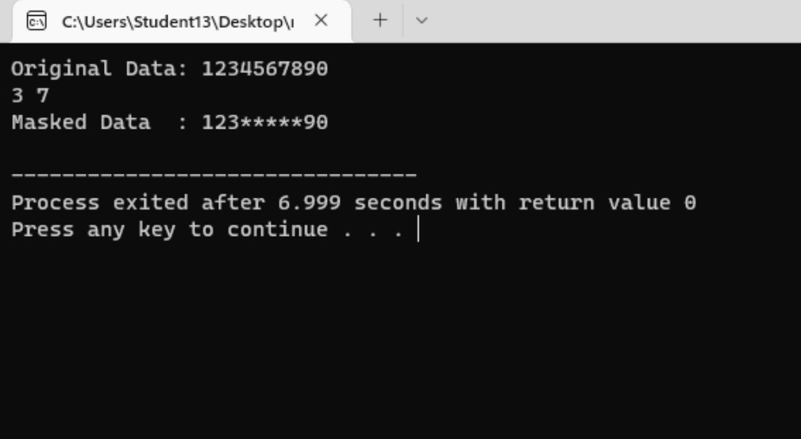
Encryption example data masking example

Slide 14
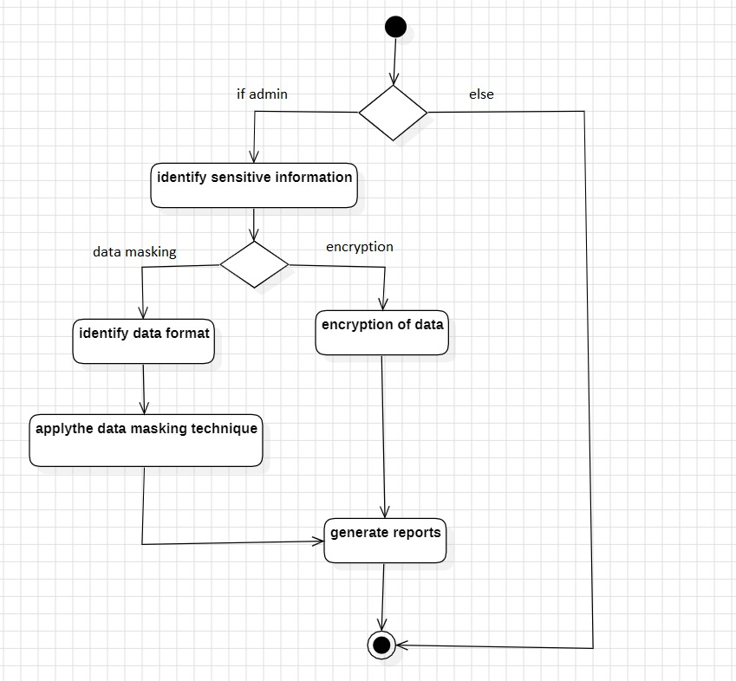
ACTIVITY DIAGRAM

Slide 15
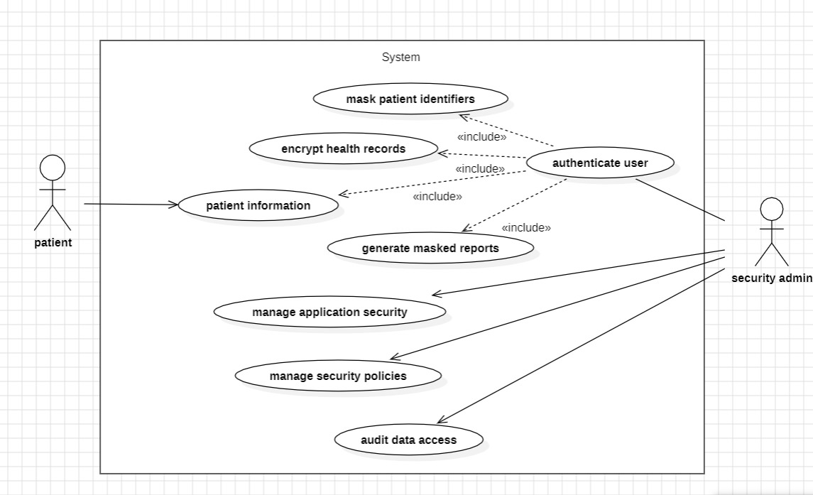
USECASE DIAGRAM

Slide 16
conclusion
In conclusion, the implementation of robust healthcare data protection measures, particularly through the strategic use of data masking and encryption, is paramount in ensuring the confidentiality, integrity, and availability of sensitive patient information. As the healthcare industry continues to evolve in the digital era, where vast amounts of data are generated and shared, the need for comprehensive security strategies becomes increasingly evident.

Slide 17


